Slide 1
Learning & Development Enabling development, Impacting growth…
Cognos 11 (IBM Cognos Analytics) – Training
Query Studio

Slide 2
Module Objectives :
What is Query Studio?
Package
Adding Data to Ad Hoc Reports
List Reports
Crosstab Reports
Display Data Graphically with Charts
Custom Groups

Slide 3
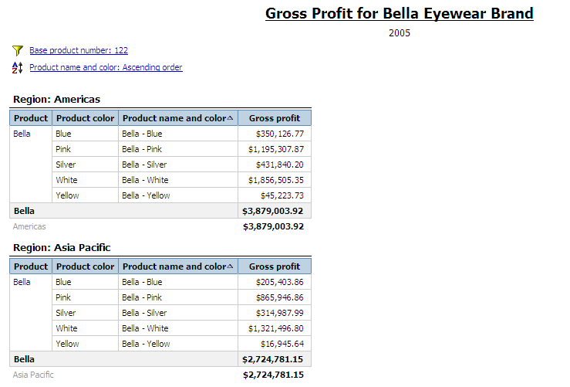
What is Query Studio ?
What is Query Studio?
A web based tool allowing users to build ad-hoc queries and reports hereby helping in exploring data and facilitate in ad-hoc reporting.
Key Capabilities
Ad-hoc Reporting: Drag-and-drop trusted content, filters, and calculations. Modify and arrange layout, add colors and text.
Share findings: User can create his own reports and share them in different formats.
Benefits
Enhances self-service: Easy ad-hoc report creation empower business users
Detail insight into data: Quick way for in-place data exploration
Reduces IT bottlenecks: Facilitate self-service while leverage information from trusted and properly IT governed content

Slide 4
What is Query Studio ?
Features:
In Query Studio one can create reports having,
Lists / Grouped Lists
Crosstabs
Charts
Reports can be formatted and filtered.
Sorting and Grouping can be done on the data.
Calculations can be added to the existing data.
Drill up and Drill down can be done.
Lineage information can be obtained for the existing data items.
Report can be run and viewed in pdf, csv, xml and excel format.
Notes:
4
4

Slide 5
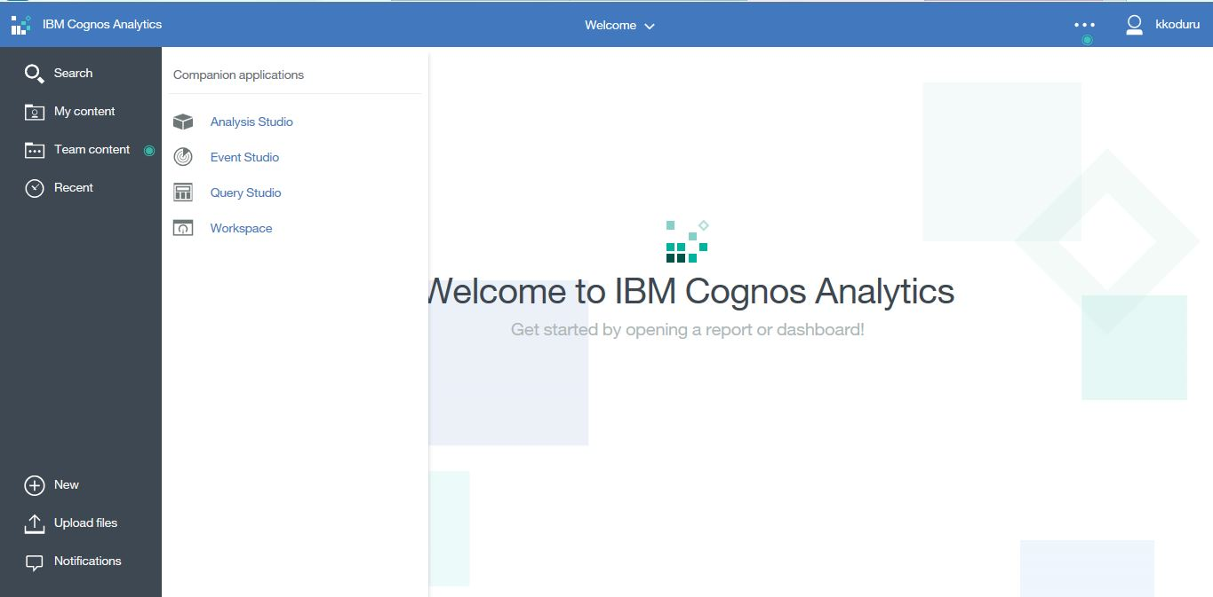
What is Query Studio ?
User Interface
Access the Query Studio tool from the Cognos Analytics web portal.
Notes:
5
5

Slide 6
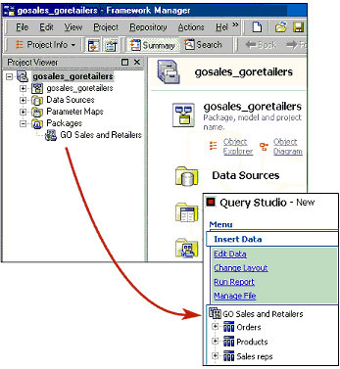
Package - Usage of Package
Reports that are created in Query Studio are based on “packages” that are published from Cognos 11’s metadata management component, i.e. Framework Manager.
Packages isolate report authors and users from database complexities.
This is done by incorporating business rules to define and group the data to be used for business reporting.
Notes:
6
6

Slide 7
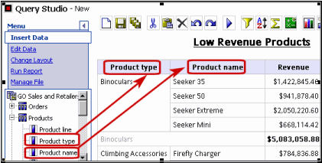
Adding data to Ad Hoc Reports
Business authors can:
Easily add data to an empty report by “dragging and dropping” the report items from the package.
Expand the scope of an existing report by inserting additional report items.
Notes:
7
7

Slide 8
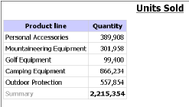
List Reports
List Reports show columns of information, such as “product lists” or “customer lists”.
Apply a filter, summary, or calculation to manipulate the data that appears in the report
By default, Query Studio:
automatically suppresses duplicates
summarizes detail values, and
generates footer summaries for measures
Notes:
8
8

Slide 9
List Reports – Demonstration: Create a List Report
Steps:
In the Cognos Analytics home page, click the Team Content tab.
Click the GO Sales and Retailers package.
Click the Query Studio link.
Expand Products.
Double-click the Product line item.
Expand Orders.
Double-click the Quantity item.
At the top of the report, click the Title link.
In the Title box, type Units Sold.
Click the Save button on the toolbar
In the Name box, type Units Sold.
Leave the default destination folder as Team Content, and click OK.
Notes:
9
9

Slide 10
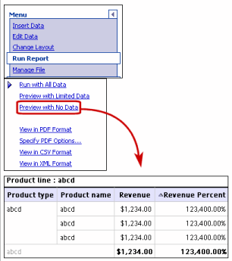
List Reports – Demonstration: Run Options
You can run a report to retrieve any recently updated data from the data source.
Run Options available are:
Run with Prompts
Run with All Data
Preview Reports with Limited Data
Preview Reports with No Data
Notes:
10
10

Slide 11
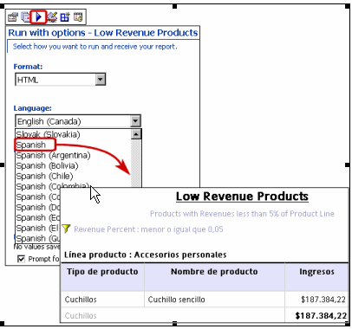
List Reports – Demonstration: Specify Language
Set the language:
on Run with options page
in the Report properties
in the Preferences section of Cognos Connection.
Notes:
Note:
Business authors can set the default language to be used when a report is run. Users have the complete flexibility to automatically personalize reports based on their language preferences.
None

Slide 12
List Reports – Demonstration: Run Options
Open the report that you want in Query Studio.
From the Run Report menu, choose how to run the report:
To run the report using all data, click Run with All Data.
To run the report using limited data, click Preview with Limited Data.
Note: If the package that the report is based on contains a design filter, performance is improved.
To run the report using no data, click Preview with No Data.
Notes:
None

Slide 13
List Reports – Demonstration: Run Options
Steps
To run the report using limited data, click Preview with Limited Data.
Note: If the package that the report is based on contains a design filter, performance is improved.
To run the report using no data, click Preview with No Data.
Notes:
None

Slide 14
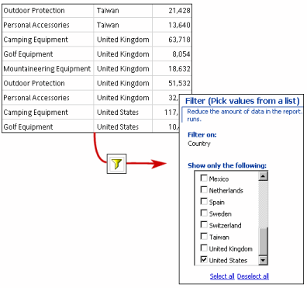
List Reports - Filters
Filter is used to specify the subset of records that the report retrieves.
Textual, numeric, or date and time data can be filtered.
While filtering measures, the filter can be applied to:
details
summaries in reports that contain summaries
Notes:
Filters:
Filtering Based On Report Details: When you filter on “details”, you filter the values that appear in the detail rows of your report.
Filtering Based On Group Summaries: When you filter on “summaries”, you filter the values in the “footers”. Filtering on summaries eliminates groups from your report.
When filtering on a “numeric report item”, users specify a range of acceptable values (for example, one to five). When filtering on a “non-numeric column”, users specify the particular values that will be returned when the report is run (for example, United States only).
Business authors can also use predefined filters that are included in the published package (model filters). However, they cannot edit these filters in Query Studio. They can only insert or remove them from their report.
None

Slide 15
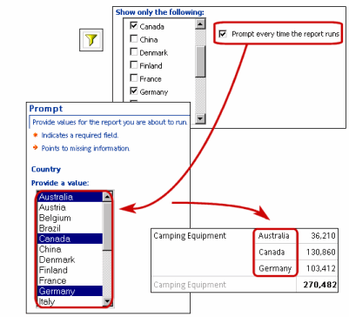
List Reports - Specifying Filter Criteria with Prompts
A “prompt” is used when you want to use different criteria for the same report item each time the report runs.
Using prompts is faster and easier than repeatedly changing the filter.
Notes:
Specifying Filter Criteria with Prompts:
Prompts are based on filters. Authors specify the values they want to include in the filter. When the report is run, the contents of the report reflect one or more values selected in the prompt.
In the example shown in the slide, the user must select one or more countries to determine what data they want to see in the report. The user selected Australia, Canada, and Germany, so the resulting report contains data only for those countries.
None

Slide 16
List Reports – Demonstration: Specifying Filter Criteria with Prompts
Steps
Open the Units Sold report.
Click Product Line column.
Click the Filter button on the toolbar.
Select the Prompt every time the report runs check box.
Click OK.
Run the report.
Notes:
None

Slide 17
List Reports – Sort
Sorting organizes your data in ascending or descending:
alphabetical order, or
numeric order
For example:
You can sort on a column that lists product sales in a descending order in order to rank product sales from the highest to the lowest.
When sorting grouped data, you can choose to sort the “detail values” or the “summary values” in the footers.
Notes:
None

Slide 18
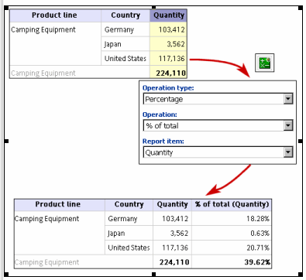
List Reports – Calculate
You can add value to reports by calculating the data in one or more columns.
Notes:
Calculate:
Calculate numeric data by using arithmetic, percentage, or analytic operations.
Calculate strings by:
specifying the first or last characters of the string,
concatenating (combining) the selected string with another string, or
removing the trailing spaces from the string.
Calculate time data by using a variety of methods, such as adding days or months to a selected date.
In the example shown in the slide, we are calculating the percentage that each country’s sales of camping equipment contributed to the total. You can see that the United States represents the largest contributor, at 52.27%.
None

Slide 19
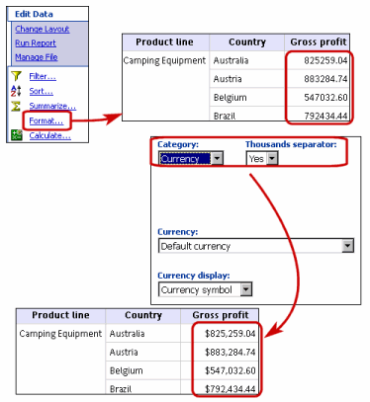
List Reports – Format
Predefined formats are used to change the appearance of numbers, dates.
The various formats used are:
Default
Number
Currency
Percentage
Scientific
Date and Time
Notes:
Format:
Default: The “default format” is the format of the report item before any formatting is applied in Query Studio. Use “default format” to remove formatting.
Number: Use the “number format”:
to change the number of decimal places,
to specify whether to use a thousands separator,
to choose different symbols to represent negative numbers, and
to scale large numbers.
Currency: You can choose from many world currencies. Use either the currency symbol or the international code.
For example: The currency symbol for the euro is € and the international code is EUR.
You can also change the number of decimal places, specify whether to use a thousands separator, choose different symbols to represent negative numbers, and to scale large numbers.
Percentage: This format shows a number multiplied by 100, by using two decimal places and a percent sign.
For example: 0.7356 appears as 73.56%.
Scientific: This format shows a number in exponential notation.
For example: The number 224,110 is 2.24110E+05 in scientific notation.
Date and Time: You can choose from a list of date and time formats, including the 12 hour or 24 hour clock.
None

Slide 20
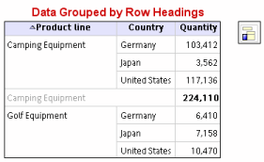
List Reports – Grouping
Grouping a report sorts the data, and suppresses duplicate values in the grouped column.
Notes:
Grouped List Report:
A simple List Report that contains columns of unique values is easy to understand. However, after you add more columns, you may find that duplicate values appear in your report.
For example: A report contains information about the quantity of units sold, in columns named Product line, Country, and Quantity. Each product line is sold in more than one country, so the same product line value appears in multiple rows in the Product line column.
You group a List Report by product line to:
suppress duplicate values of the product line report item
alphabetically sort the product lines
generate footer summaries for each product line
None

Slide 21
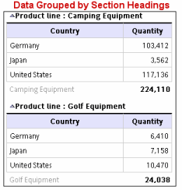
List Reports – Sections
Creating sections shows the value of a selected report item as the heading of a section.
Notes:
None

Slide 22
List Reports – Demonstration: Create a Grouped List Report
Steps:
Open the Units Sold report.
Click the heading of the Quantity column.
Click the Insert Data menu command.
Expand Countries.
Double-click the Country item.
Click the heading of the Country column.
Click the Filter button on the toolbar.
Notes:
None

Slide 23
List Reports – Demonstration: Create a Grouped List Report
Steps:
In the Show only the following box, select Germany, Japan, and United States, and then click OK.
Click the heading of the Product line column.
Click the Group button on the toolbar.
Click the Save as button on the toolbar.
In the Name box, type Grouped Units Sold.
Leave the destination folder as Team Content, and click OK.
Notes:
None

Slide 24
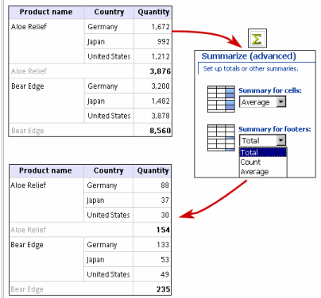
List Reports – Add Summarized Data
Predefined summaries can be used to calculate the following for the values in individual report items:
total
count
maximum
minimum
average
Notes:
Add Summarized Data:
In the example shown in the slide, we are calculating the average sales of three products in Germany, Japan, and the United States.
In the example, the average order of Aloe Relief in the United States was for 30 units. The total of these average sales is 154.
None

Slide 25
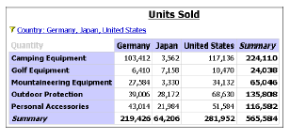
Crosstab Reports
A Crosstab report shows a measure at the intersection of each row and column.
Notes:
Crosstab Reports:
A Crosstab report shows a measure at the intersection of each row and column. This is useful for showing more information in a smaller area.
For example: If a report shows Product line as columns, Country as rows, and Quantity as the measure, then the value at the intersection of each column and row shows the quantity of units sold for that Product line and that country.
None

Slide 26
Crosstab Reports - Demonstration: Create a Crosstab Report
Steps:
Open the Grouped Units Sold report.
Click the heading of the Country column.
Click the Pivot button on the toolbar.
Note: The values of the Country column are now column headings. The values of the Product line column become row headings. The measure is at the intersection of the two.
Click the Save as button on the toolbar.
In the Name box, type Crosstab Units Sold. Leave the destination folder as Team Content, and click OK
Notes:
None

Slide 27
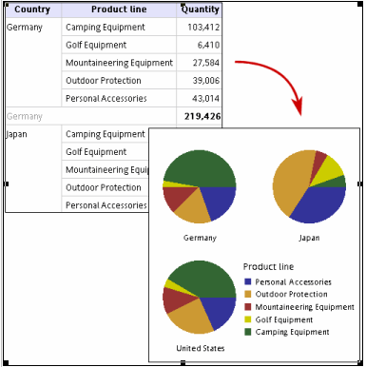
Display Data Graphically with Charts
Business authors can create a chart to graphically present the information.
Charts are useful for displaying patterns and trends in data.
Notes:
None

Slide 28
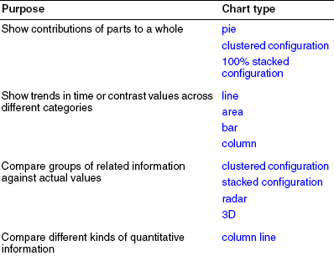
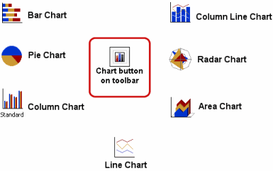
Display Data Graphically with Charts - Chart Types
Notes:
Chart Types:
Charts are used to graphically present the information. A report requires at least “one measure” and “one non-measure” to produce a chart.
Measures are quantitative data, such as figures for sales, costs, and quantities.
Non-measures are qualitative data, such as names, addresses, and countries.
The maximum number of non-measures is two. You can plot any number of measures in a report.
However, a chart that has more than four or five measures is difficult to understand.
None

Slide 29
Data Graphically with Charts - Chart Types
Steps
Open the Units Sold report.
Click the Chart button on the toolbar.
In the Chart type box, click Pie.
Click 100% Stacked.
Select the Show the values on the chart check box.
In Show the following in the report, click Chart only, and then click OK
Click the save as button on the toolbar.
In the Name box, type Units Sold Pie.
Leave the destination folder as Team Content, and then click OK.
Notes:
None

Slide 30
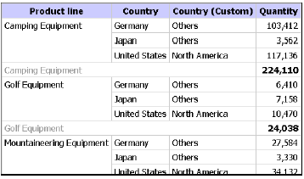
Custom Groups
Custom Groups are created to produce a new report item containing values that are meaningful to you.
Use Custom Groups to convert a list of numeric results into broader categories.
For example: Break down sales results into Low, Medium, and High.
Notes:
None

Slide 31
Custom Groups -Demonstration: Create a Custom Group
Steps:
Open the Grouped Units Sold report.
Click the heading of the Country column.
From the Edit Data menu, click Define Custom Groups.
In the New group name box, type North America.
Click the down arrow link to add it to the Custom groups box.
In the Available values box, click Canada.
Notes:
None

Slide 32
Custom Groups -Demonstration: Create a Custom Group
Steps:
Click the left arrow link to add it to the Custom group values box. This creates a new custom group named Others that includes all values that do not belong to the custom group North America.
Click Insert. A new column Country (Custom) is displayed, containing the value North America.
Click the Save as button on the toolbar.
In the Name box, type Custom Group Example.
Leave the destination folder as Team Content, and click OK.
Notes:
None

Slide 33

Lab Workout
Do the following tasks:
Create a Simple List Report.
Create a Grouped List Report.
Create a Cross tab Report.
Create a Chart.
Create Custom Groups.
Notes:
None

Slide 34

Summary
In this lesson, you have learnt,
to create simple list and cross tab report
to group data and create sections
to filter data using prompts
to create charts
to create custom groups
Notes:
None

Slide 35

Review – Questions
Question 1: A ___ report shows a measure at the intersection of each row and column.
Option 1: List
Option 2: Chart
Option 3: Crosstab
Question 2: Using prompts is faster and easier than repeatedly changing the filter
True / False
Notes:
None

Slide 36
Review – Questions
Question 3: ___ is used to convert a list of numeric results into broader categories.
Notes:
None

Slide 37
Q & A

Slide 38
Thank You
Review Date | 14-July-2016
Version | 1.0
Next Review Due | 14-July-2017

